Slide 1

Understanding the Enrollment Rate Drop in Key Accounts Motion
January 31, 2019

Slide 2
Presentation Outline
Background
Methods
Key Accounts (KA) motion enrollment rate
Comparison between eligible members
Comparison between enrolled members
Comparison between active among enrolled members
Demographics, health, claims
Overall conclusion

Slide 3
BACKGROUND
Sizeable drop in Key Account motion enrollment rate
July 2018 monthly motion report:
Enrollment rate
From 64% in July 2017 down to 42% in July 2018
Active rate among the enrolled
From 61.9% in July 2017 down to 44.3% in July 2018
Killer questions:
How do member characteristics, particularly those related to health, compare?
Between those that were eligible in July 2017 and July 2018
Between those that were enrolled in July 2017 and July 2018
Between those that were active in July 2017 and July 2018

Slide 4
METHODS
Data source: identified via pharmacy and medical claims data with UHC
Population: Members of employers eligible for Key Account Motion
Time period:
Group 1: July 2016 – July 2017
Group 2: July 2017 – July 2018
Definitions:
- Eligible: enrolled in UHC and eligible to participate in KA motion program
- Enrolled: enrolled in KA motion program
- Active: had at least 100 steps during at least a day, and do not have an
incentive adjustment < $40 during the month
Amounts > 99.5 percentile of extreme normalized values were removed from analyses

Slide 5
KA MOTION ENROLLMENT RATE
How many have enrolled in the program?
There was a sizeable drop in the enrollment rate in the Key Accounts Motion program.
Year Month | Eligible | Enrolled | Enrollment Rate
July 2017 | 14071 | 9730 | 69.1%
July 2018 | 36438 | 16672 | 45.8%

Slide 6
AMONG ELIGIBLE MEMBERS
Difference in Demographics
No sizeable differences in demographics between the groups of eligible members
Demographic Comparisons
 | July 2017 | July 2018 | Effect Size Magnitude
Age | 44 | 43 | Negligible
Median Income | $61,005 | $62,052 | Negligible

Slide 7
AMONG ELIGIBLE MEMBERS
Difference in RAF and Prevalence Conditions
July 2018 have RAF scores 0.14 lower
Continuous enrollment shows no difference in RAF scores
RAF Score Comparisons
RAF scores of continuously UHC enrolled
 | July 2017 | July 2018 | Effect Size Magnitude
RAF Score | 0.95 | 1.01 | No Difference
Notes:
July 2018 RAF scores are 15% lower than in July 2017 RAF scores
July 2018 RAF scores are 6% lower than in July 2017 RAF scores (continuously enrolled)

Slide 8
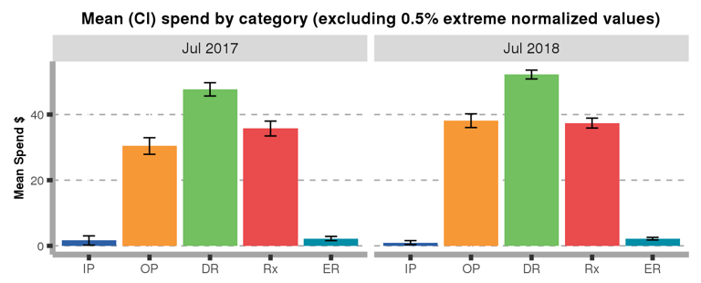
AMONG ELIGIBLE MEMBERS
Difference in healthcare costs
July 2018 have $20 higher total costs, $8 higher for OP, $6 higher for DR
Healthcare $ Spending Comparisons
$52.2
$46.7
$35.7
$38.1
$30.4
$37.4
$1.6
$2.2
$1.0
$2.2
 | July 2017 | July 2018 | Effect Size Magnitude
Total Allowed Amount | $188.4 | $208.2 | Negligible

Slide 9
AMONG ENROLLED MEMBERS
Difference in Demographics
No sizeable differences in demographics between the groups of enrolled members
Demographic Comparisons
 | July 2017 | July 2018 | Effect Size Magnitude
Age | 44 | 43 | Negligible
Subscriber | 78.8% | 82.2% | Negligible
Median Income | $61,005 | $62,052 | Negligible

Slide 10
AMONG ENROLLED MEMBERS
Difference in RAF and Prevalence Conditions
July 2018 have RAF scores 0.07 lower
Continuous enrollment shows no mean difference in RAF scores
RAF Score and Percentage Prevalence Comparisons
RAF scores of continuously UHC enrolled
 | July 2017 | July 2018 | Effect Size Magnitude
RAF Score | 1.40 | 1.31 | No Difference
Notes:
July 2018 RAF scores are 15% lower than in July 2017 RAF scores
July 2018 RAF scores are 6% lower than in July 2017 RAF scores (continuously enrolled)

Slide 11
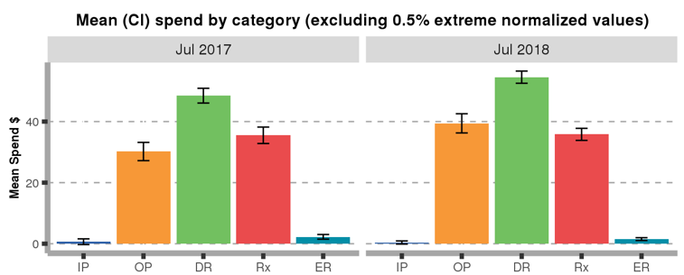
AMONG ENROLLED MEMBERS
Difference in healthcare costs
July 2018 have $27 higher total costs, $6 higher for OP, $9 higher for DR
Healthcare $ Spending Comparisons
$54.5
$48.5
$39.4
$30.2
$35.5
$35.8
$0.7
$2.3
$0.4
$1.5
 | July 2017 | July 2018 | Effect Size Magnitude
Total Allowed Amount | $171.3 | $198.0 | Negligible
Notes:
July 2018 has OP costs 30% higher than July 2017
July 2018 has DR costs 12% higher than July 2017
July 2018 has Total costs 15.6% higher than July 2017

Slide 12
KA MOTION ACTIVE RATE
How many enrolled members are active in the program?
There was a drop in the percent of who are active among those enrolled
Year Month | Enrolled | Active | Active Rate
July 2017 | 9730 | 6772 | 69.6%
July 2018 | 16672 | 8880 | 53.3%

Slide 13
ACTIVE AMONG ENROLLED
Difference in Demographics
No sizeable differences in demographics between active among enrolled members
Demographic Comparisons
 | July 2017 | July 2018 | Effect Size Magnitude
Age | 45 | 44 | Negligible
Subscriber | 79.2% | 82.3% | Negligible
Median Income | $61,303.21 | $63,288.62 | Negligible

Slide 14
ACTIVE AMONG ENROLLED
Difference in RAF and Prevalence Conditions
No sizeable differences in RAF and percentage of prevalence conditions between the groups of active among enrolled members
RAF Score and Percentage Prevalence Comparisons
RAF scores of continuously UHC enrolled
 | July 2017 | July 2018 | Effect Size Magnitude
RAF Score | 1.40 | 1.31 | No Difference

Slide 15
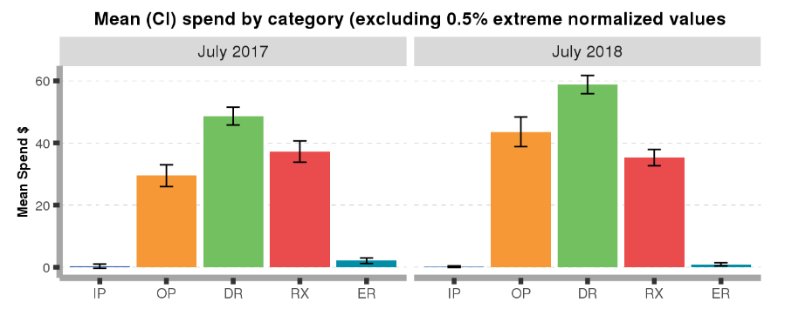
ACTIVE AMONG ENROLLED
Difference in Healthcare Spending
July 2018 had a little higher costs for OP, DR, ER, and Total healthcare services
Healthcare $ Spending Comparisons
$58.8
$48.7
$37.3
$43.6
$35.3
$29.5
$0.3
$2.1
$0.2
$0.9
 | July 2017 | July 2018 | Effect Size Magnitude
Total Allowed Amount | $170.0 | $191.4 | Negligible

Slide 16
ACTIVE AMONG ENROLLED
Difference in PMPM Spending
July 2018 active among enrolled members have higher month on month spending on healthcare
PMPM Spending Comparisons
 | July 2017 (N=6772) | July 2018 (N=8880) | Observed Difference | Bootstrap CI
PMPM (13 month period) | $331.0 | $385.6 | $54.6 | ($7.54, $102.32)

Slide 17
CONCLUSION
Overall Findings
Excluding catastrophic circumstances July 2018 group
Between eligibles: Had 15% lower RAF, little higher IP, DR, total $ costs
Between enrolled: Had 8% lower RAF, little higher IP, DR, total $ costs
Between active among enrolled: Had 10% lower RAF, OP, DR, Total, lower ER $ costs
There are no major differences between the two groups compared. Hence, the changes in enrollment and activity cannot be explained by demographic factors, health conditions, and healthcare spending.

